Slide 1
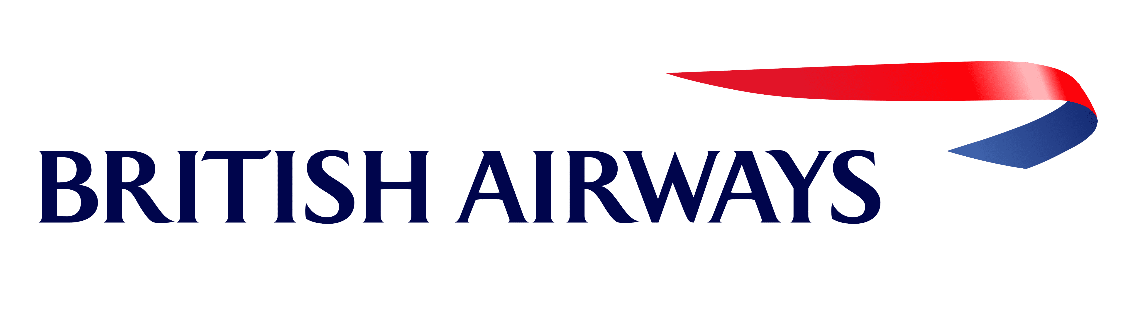
Web scraping to gain company insights
24/08/2023

Slide 2
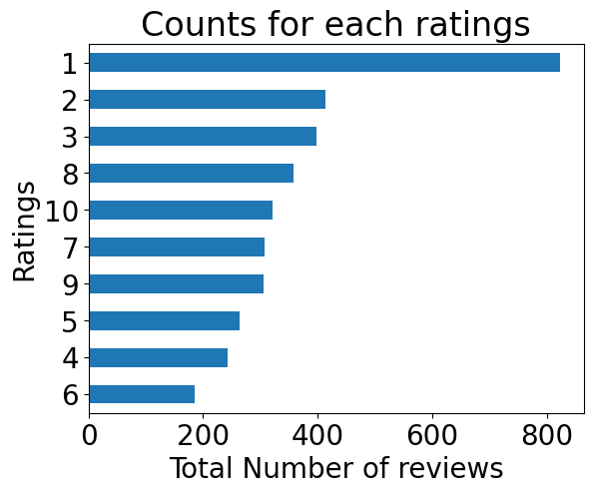
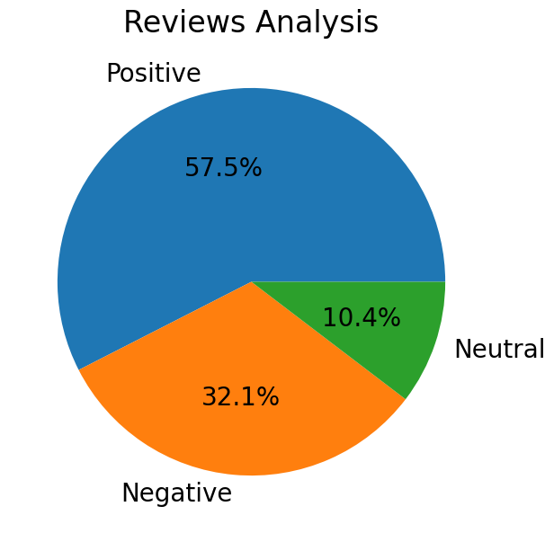
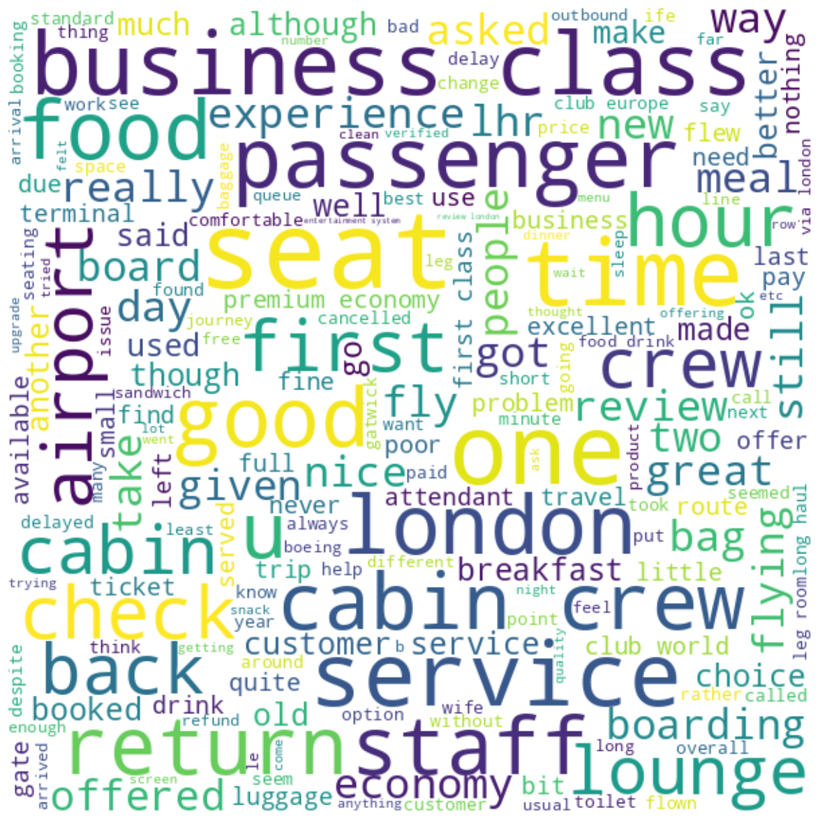
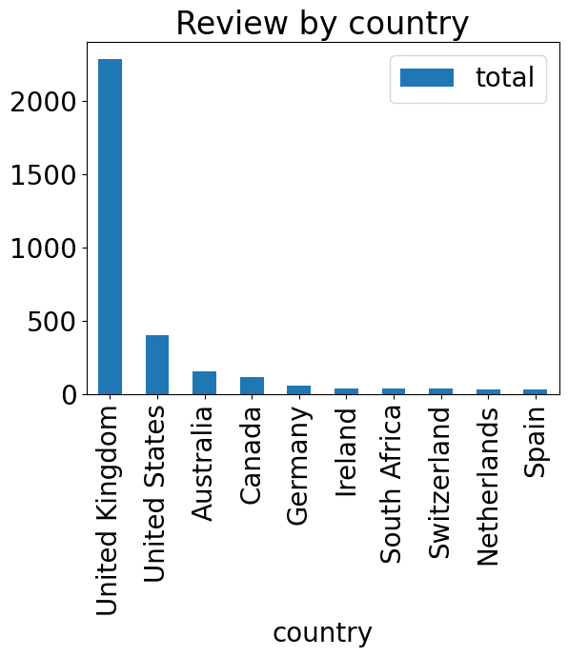
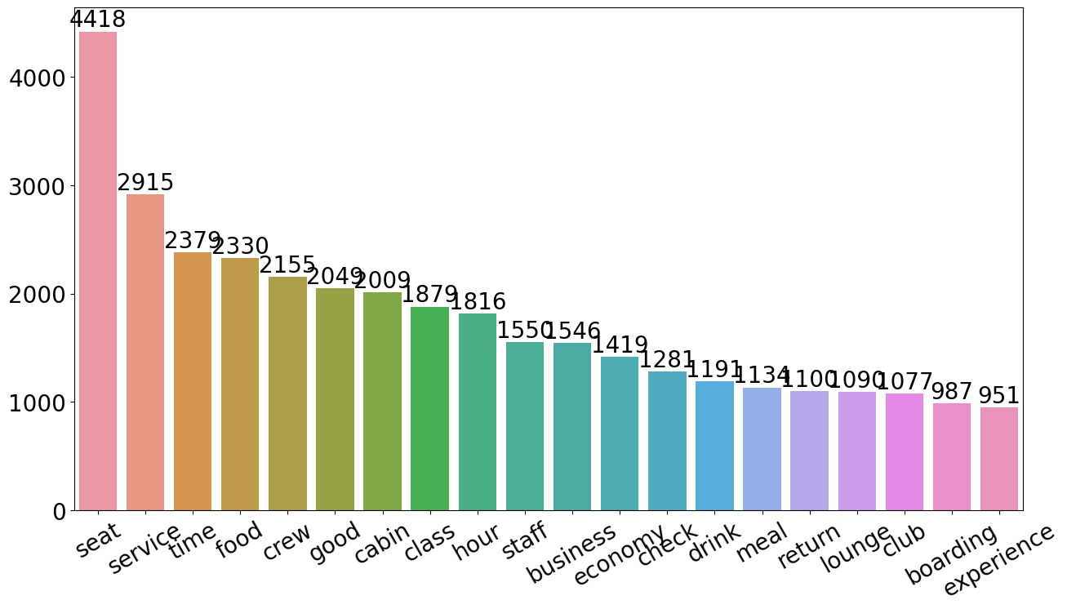
INSIGHTS FROM CUSTOMER REVIEWS
Average Overall Rating
4.76 /10
Word Cloud
3618 Total reviews
collected
Reviews from 71 Countries
Most used word
Customers like seat, service, food, cabin and staff. Many travelled in Business class.
Focus on – Economy class service, enhance inflight entertainment experience and importantly delays, food .Improve Customer service on refund requests and process.

